Slide 1

ASP.NET CORE IDENTITY Authentication & Authorization
BHRUGEN PATEL
www.dotnetmastery.com

Slide 2
OVERVIEW
ASP.NET Core Identity – MVC
ASP.NET Core Identity razor class library.
Authorization
Roles
Claims
Policy
Custom Handlers

Slide 3
ASP.NET CORE IDENTITY
Fresh look at membership system.
Implemented as Razor class library in ASP.NET Core.
ASP.NET Identity, a User Store and much more.
Minimal knowledge of identity and security.
ASP.NET Identity is NOT Identity Server or ASP.NET Identity Framework.

Slide 4
AUTHENTICATION & AUTHORIZATION
Who are you?
What access do you have?
Authentication
Authorization

Slide 5


AUTHENTICATION & AUTHORIZATION
BOB

Slide 6

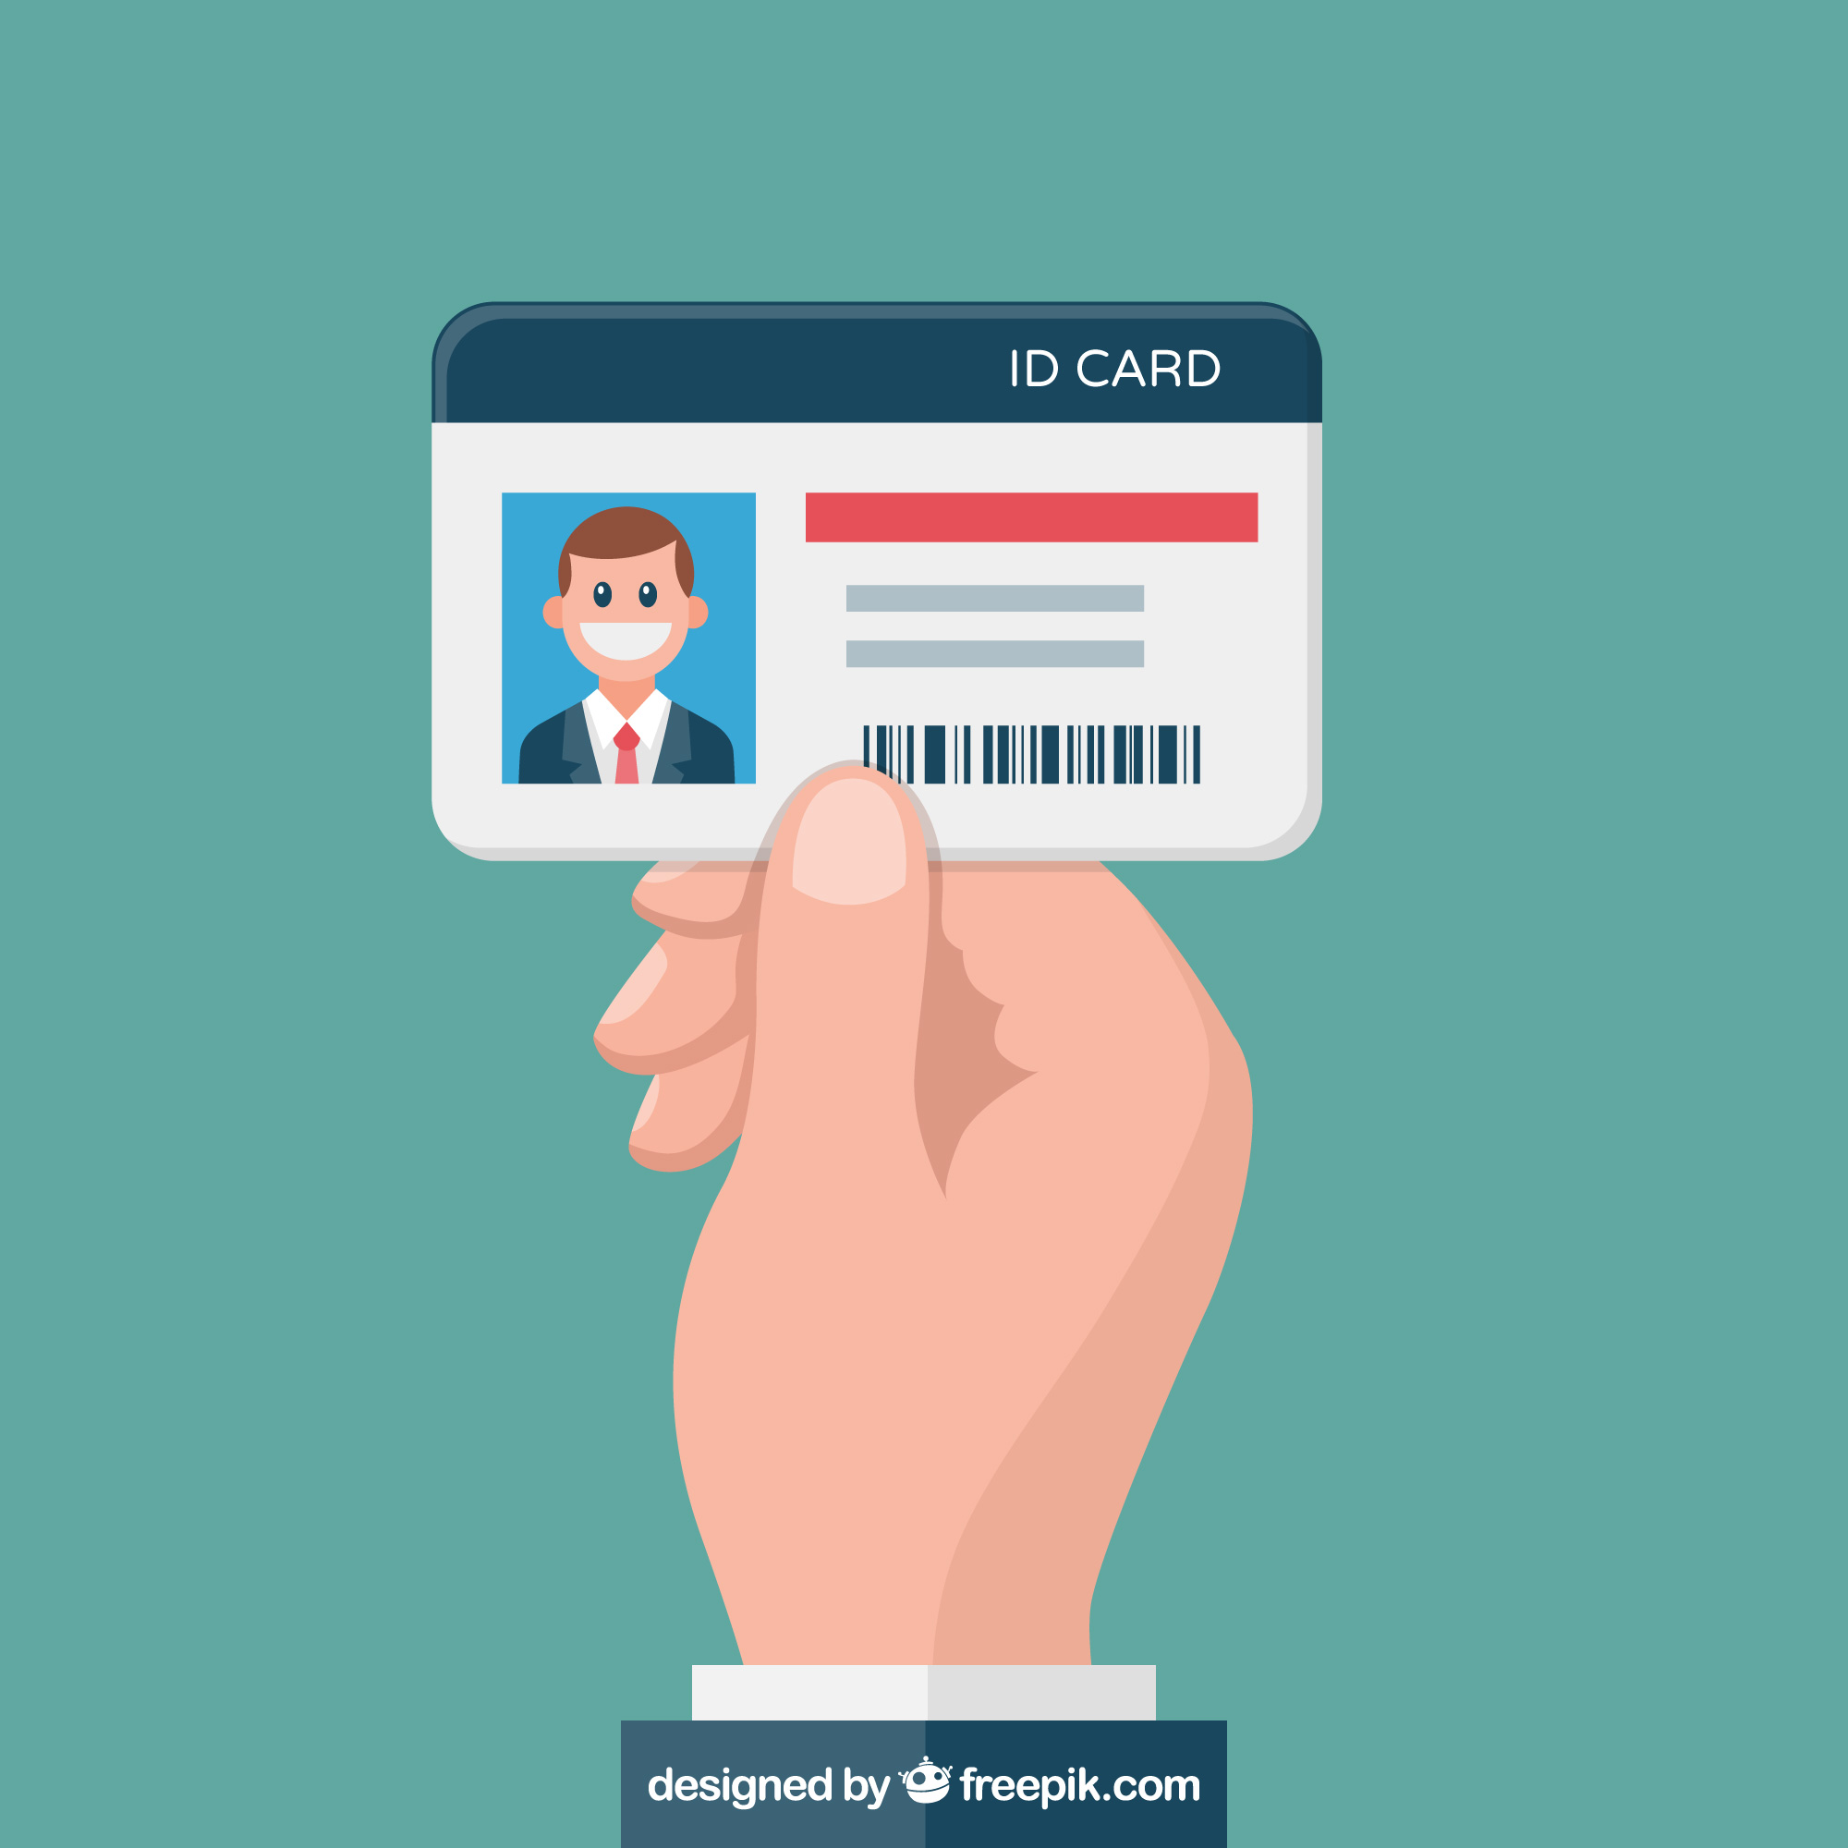
AUTHENTICATION & AUTHORIZATION

Slide 7
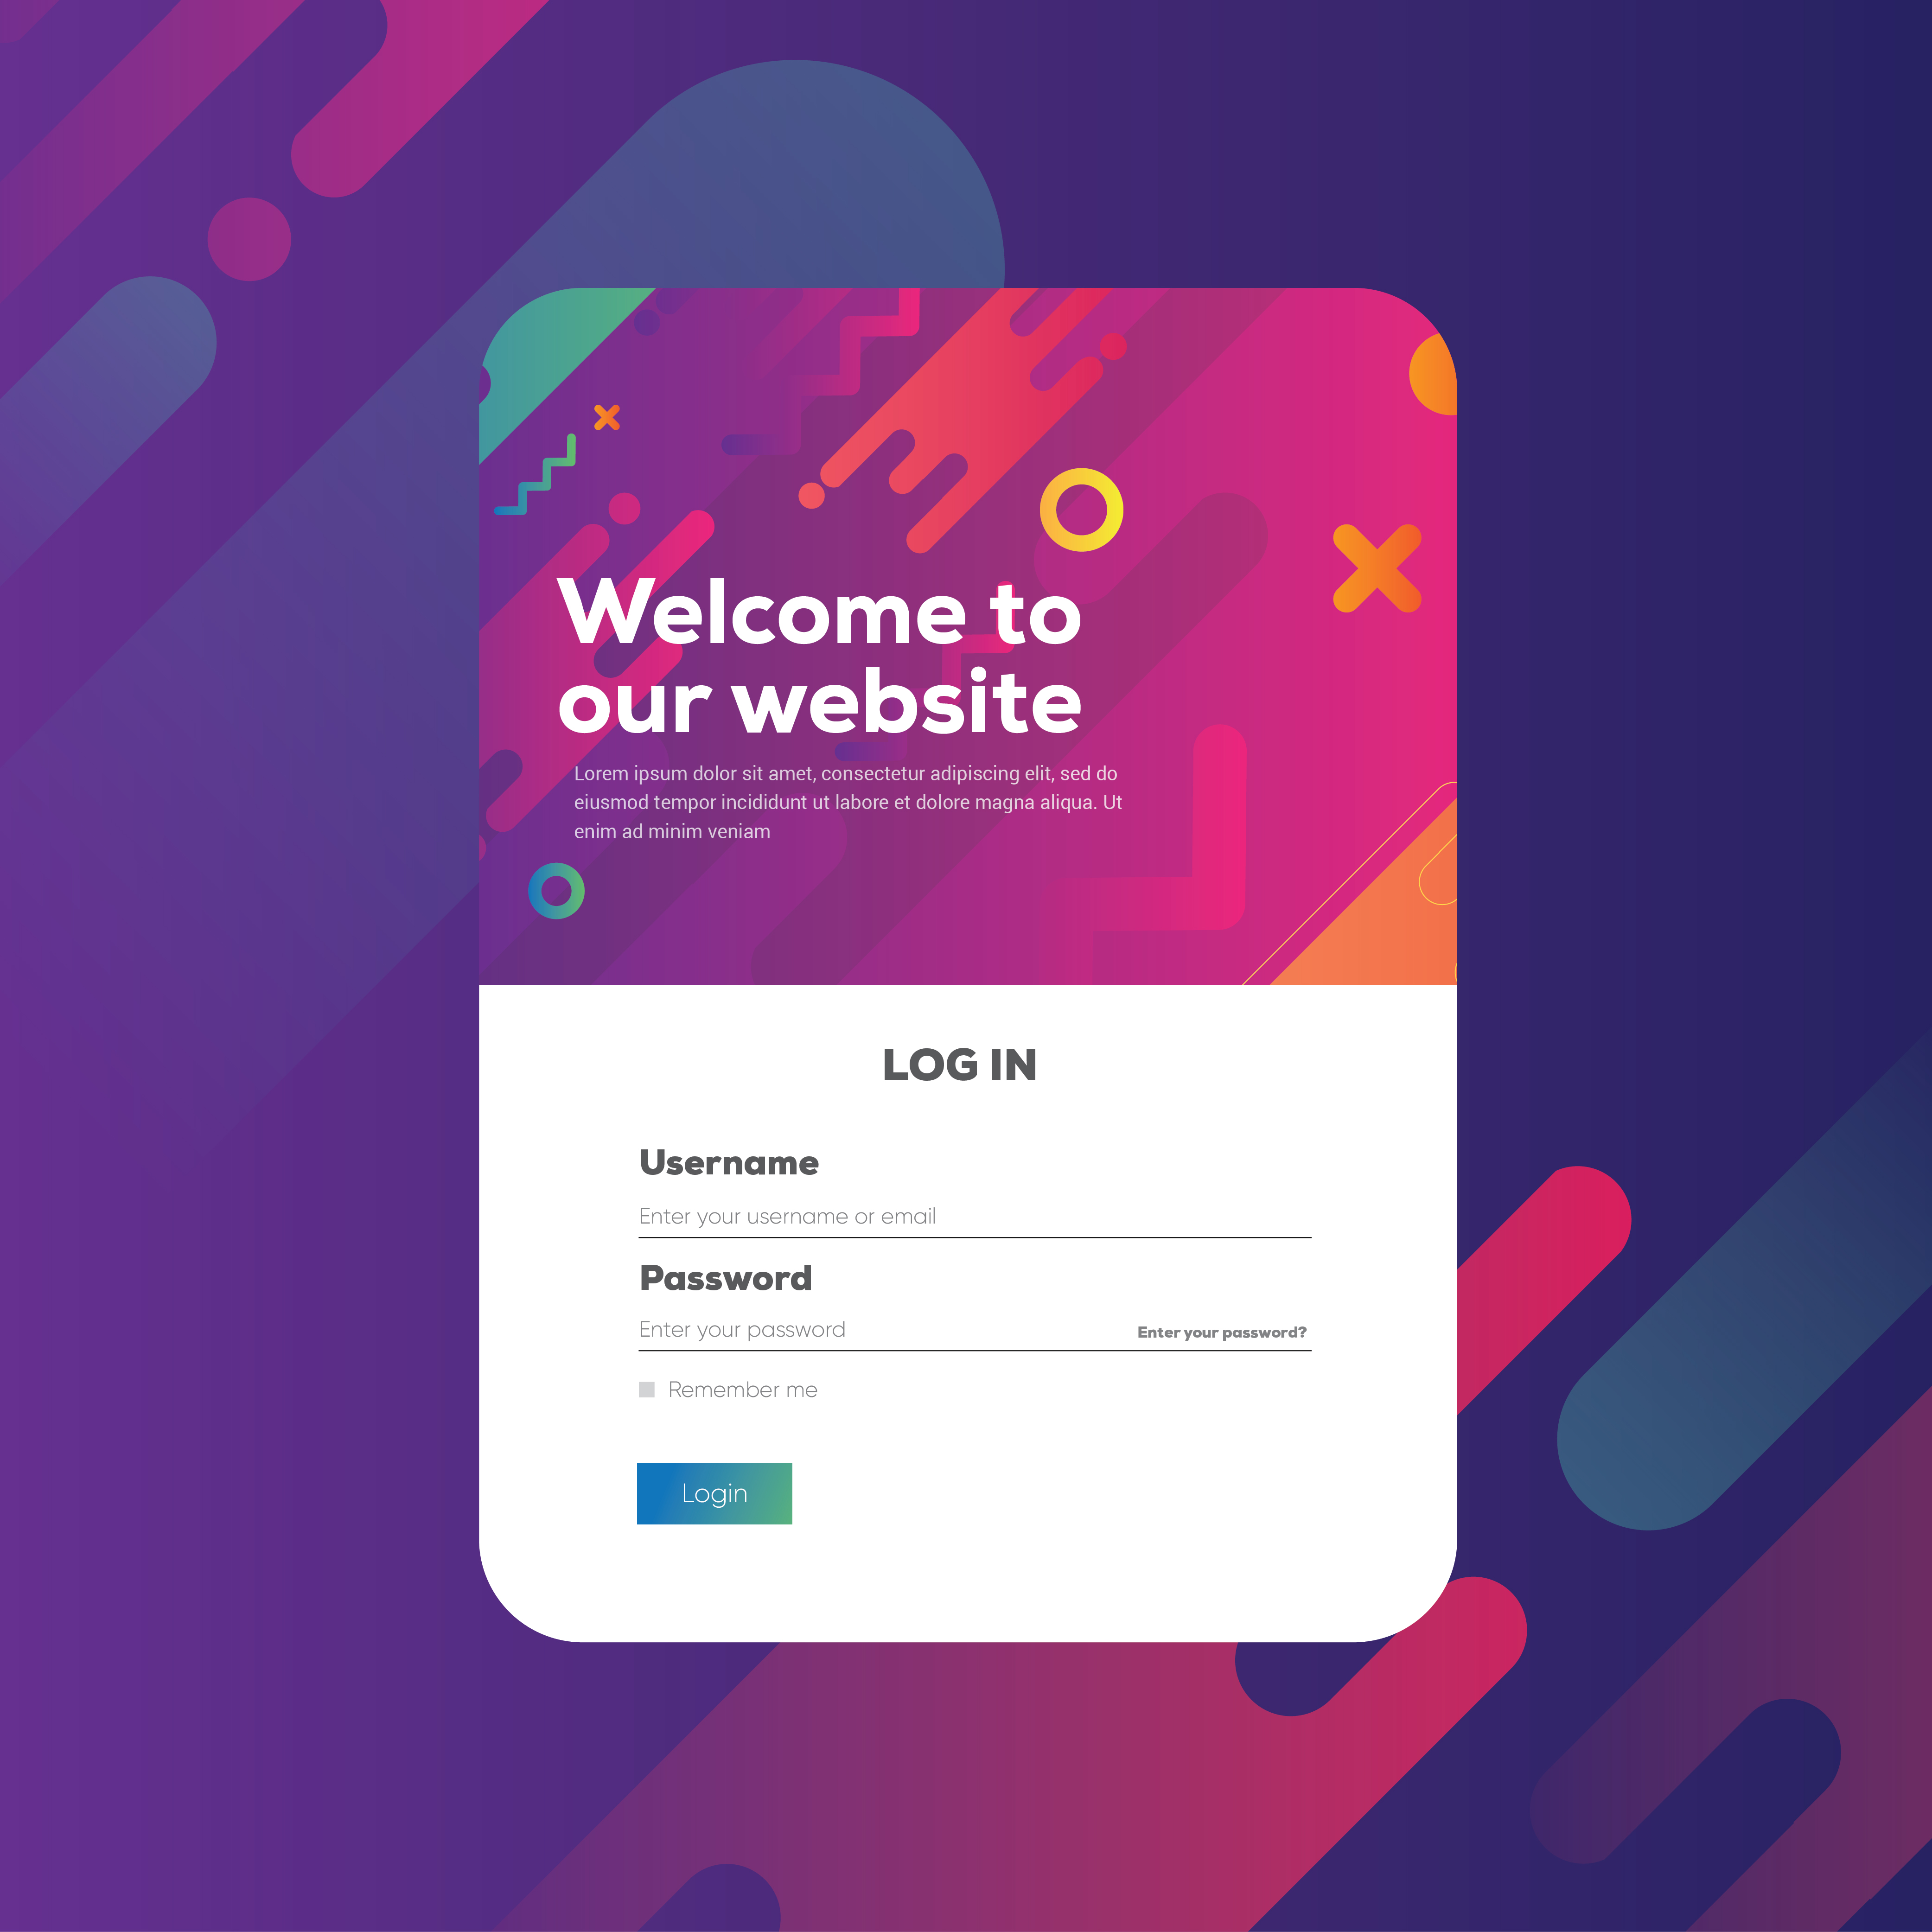
AUTHENTICATION & AUTHORIZATION

Slide 8
AUTHENTICATION & AUTHORIZATION

Slide 9




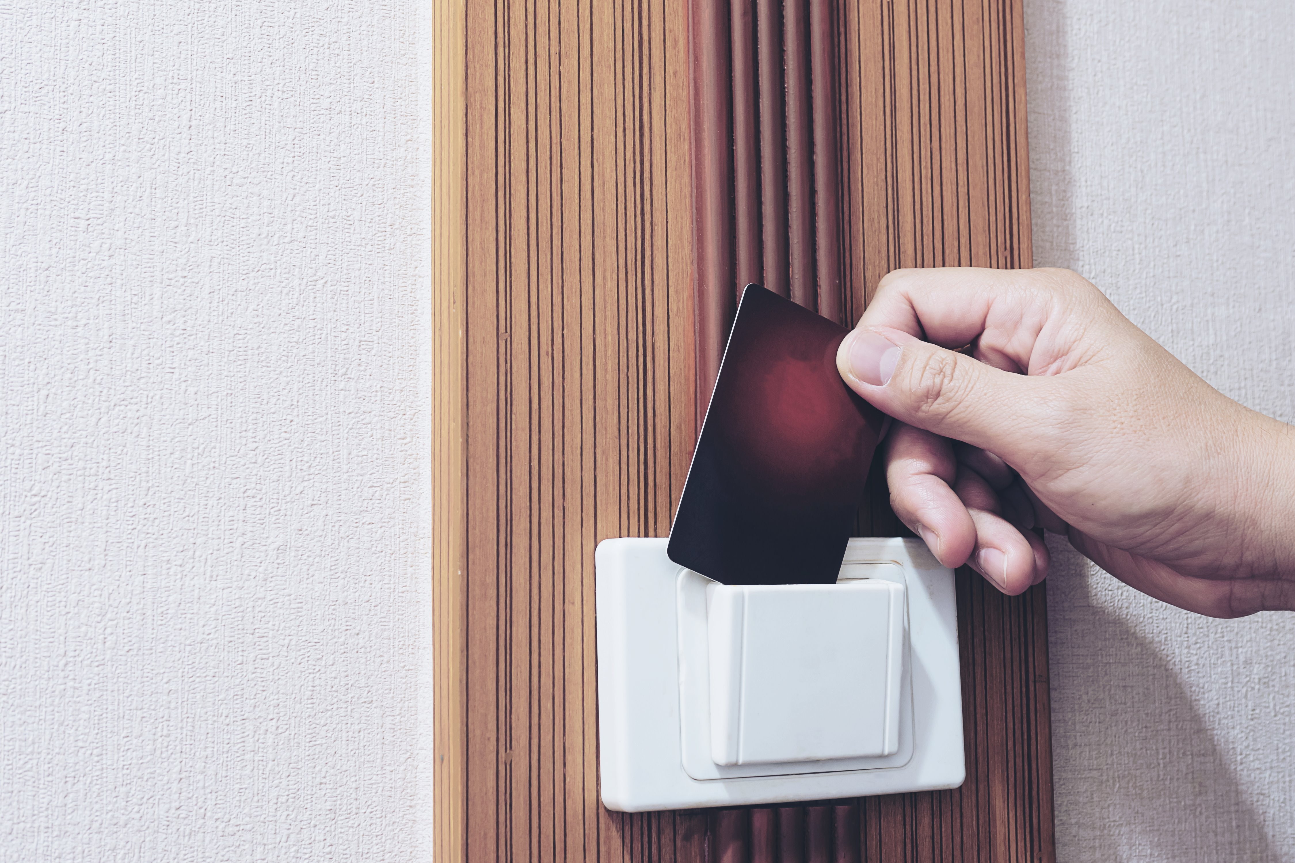



AUTHENTICATION & AUTHORIZATION
HOTEL GYM
HOTEL POOL
BOB’s ROOM
BOB’s ROOM KEY
OTHER ROOM
OTHER ROOM
STAFF ONLY

Slide 10
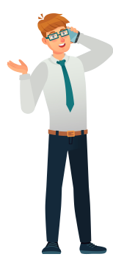
AUTHENTICATION & AUTHORIZATION
HOTEL GYM
HOTEL POOL
BOB’s ROOM
MANAGER’s ACCESS
OTHER ROOM
OTHER ROOM
STAFF ONLY

Slide 11
ASP.NET Authentication
Cookie Based Authentication
Cookie-based authentication has been the default method for handling user authentication for a long time.
Cookie-based authentication is stateful.
Token Based Authentication
Token-based authentication has gained prevalence over the last few years due to the rise of single page applications, web APIs, and the Internet of Things (IoT).
The server does not keep a record of which users are logged in or which JWTs have been issued, hence stateless.

Slide 12
Cookie Based Authentication
Let's look at the flow of cookie-based authentication:
User enters their login credentials.
Server verifies the credentials are correct and creates a session which is then stored in a database.
A cookie with the session ID is placed in the user's browser.
On subsequent requests, the session ID is verified against the database and if valid the request processed.
Once a user logs out of the app, the session is destroyed both client-side and server-side.

Slide 13
Token Based Authentication
Let's look at the flow of token-based authentication:
User enters their login credentials.
Server verifies the credentials are correct and returns a signed token.
This token is stored client-side
Subsequent requests to the server includes this token
The server decodes the JWT and if the token is valid processes the request.
Once a user logs out, the token is destroyed client-side.

Slide 14
Requirements and Handlers in Policy
We want to implement custom policy, in which we will display a special page to users whose account are over 1000 days old and user role must be “Admin”
AdminWithMoreThan1000DaysRequirement
Days = 1000
AdminWithOver1000DaysHandler<AdminWithMoreThan1000DaysRequirement>
Succeed
Fail
Do nothing

Slide 15
Logic Around Multiple Handlers/Policy
If no handler calls Succeed, access is denied.
If one of the handler calls Fail, access is denied.
If “Fail” is called access is denied, no matter what other handlers and policies return.
But all the policies are called even if access is denied.

Slide 16
Logic Around Multiple Handlers/Policy
If no handler calls Succeed, access is denied.
If one of the handler calls Fail, access is denied.
If “Fail” is called access is denied, no matter what other handlers and policies return.
But all the policies are called even if access is denied.

Slide 17
Logic Around Multiple Handlers/Policy
If no handler calls Succeed, access is denied.
If one of the handler calls Fail, access is denied.
If “Fail” is called access is denied, no matter what other handlers and policies return.
But all the policies are called even if access is denied.

Slide 18
Logic Around Multiple Handlers/Policy
If no handler calls Succeed, access is denied.
If one of the handler calls Fail, access is denied.
If “Fail” is called access is denied, no matter what other handlers and policies return.
But all the policies are called even if access is denied.

Slide 19
Structure and Architecture of ASP.NET Core Identity
User Store & Role Store [DAL]
Entity Framework Core [SQL SERVER]
User Manager & Role Manager
USER
ASPNETUSER
ROLE
ASPNETROLE
USERROLE
ASPNETUSERROLE
Sign In Manager and other Helper

Slide 20
AUTHENTICATION & AUTHORIZATION
Who the user is in a given context?
A piece of information about the user
ROLES
CLAIMS

Slide 21

TOOLS NEEDED
VISUAL STUDIO 2019
https://visualstudio.microsoft.com/vs/preview/
https://visualstudio.microsoft.com/vs/
ASP.NET Core (.NET 5)
https://dotnet.microsoft.com/download/dotnet/5.0
SQL Server 2019
https://www.microsoft.com/en-us/sql-server/sql-server-downloads

Slide 22
MFA IN ASP.NET CORE
Multi-factor authentication
Step 1 – Username & Password
Step 2 – Google/Microsoft Authenticator App

Slide 23
MFA IN ASP.NET CORE
User signs into their account with username and password
User needs to enroll in two step authentication.
User scans QR Code from website on enter code from website in their authenticator App
App will display a code that user will enter on screen to complete enrollment step.
Next time user enters valid username and password , they will have to open their authenticator App and enter the code in order to login.

Slide 24
EXTERNAL LOGIN IN ASP.NET CORE
User will login/register using Facebook.
User will be redirected to Facebook to enter credentials.
Once Facebook validates the user, user is redirected back to website.
Website completes the registration.

Slide 25
Instructions for use
In order to use this template, you must credit Slidesgo by keeping the Thanks slide.
You are allowed to:
- Modify this template.
- Use it for both personal and commercial projects.
You are not allowed to:
- Sublicense, sell or rent any of Slidesgo Content (or a modified version of Slidesgo Content).
- Distribute Slidesgo Content unless it has been expressly authorized by Slidesgo.
- Include Slidesgo Content in an online or offline database or file.
- Offer Slidesgo templates (or modified versions of Slidesgo templates) for download.
- Acquire the copyright of Slidesgo Content.
For more information about editing slides, please read our FAQs or visit Slidesgo School:
https://slidesgo.com/faqs and https://slidesgo.com/slidesgo-school

Slide 26
Fonts & colors used
This presentation has been made using the following fonts:
Libre Franklin
(https://fonts.google.com/specimen/Libre+Franklin)
Darker Grotesque
(https://fonts.google.com/specimen/Darker+Grotesque)
#1B1F42
#D80C8C
#883F98
#FFDE00
#F89829
#0397D6
#4CAE43

